Slide 1
Servlet Session Tracking II
Session API
All material and examples are from www.coreservlets.com

Slide 2
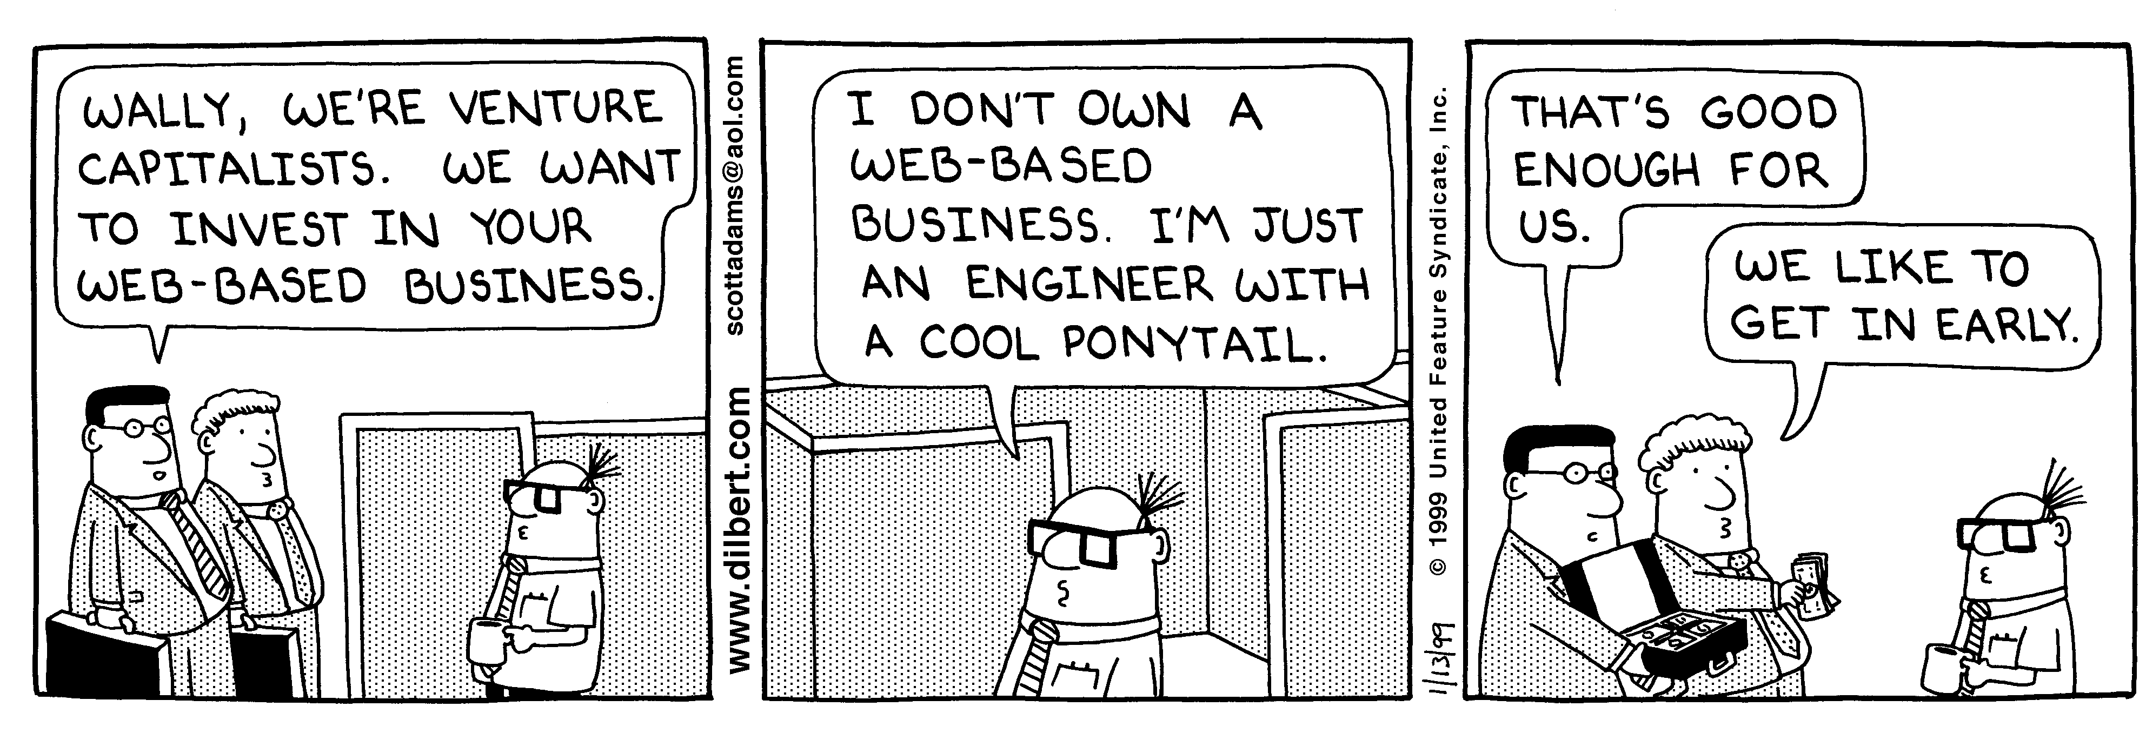
Session Tracking and E-Commerce
Why session tracking?
  HTTP is stateless and you need to keep track of transactions between requests especially for e-commerce to keep track of client purchases
  When clients at on-line store add item to their shopping cart, how does server know what’s already in cart?
    When clients decide to proceed to checkout, how can server determine which previously created cart is theirs?
Dilbert used with permission of United Syndicates Inc.

Slide 3
Session tracking is done via
Cookies
Hidden files
URL rewriting
Session API

Slide 4
Cookies
Three steps to creating a new cookie (simple):
  Create a new Cookie Object
    Cookie cookie = new Cookie (name, value);
  Set any cookie attributes
    Cookie.setMaxAge (60);
  Add your cookie to the response object:
    Response.addCookie (cookie)
Disadvantages
  cookies can be deleted / disables by client

Slide 5
Rolling Your Own Session Tracking: URL-Rewriting
Idea
  Client appends some extra data on the end of each URL that identifies the session
  Server associates that identifier with data it has stored about that session
    E.g., http://host/path/file.html;jsessionid=1234
Advantage
  Works even if cookies are disabled or unsupported
Disadvantages
  Has a lot of tedious work to do processing to do
    Must encode all URLs that refer to your own site
  Searchstring = URLEncoder.encode(serchstring)
    When redirecting, you need to use the above line to encode url to avoid illegal characters in url normally done by automatically by getParametr method ( space to + and other non-alphanumeric characters %xy hex values to ascii values).
  All pages must be dynamically generated (no static HTML pages) because you need to add userdata to url

Slide 6
Rolling Your Own Session Tracking: Hidden Form Fields
Idea:
  <INPUT TYPE="HIDDEN" NAME="session" VALUE="...">
Advantage
  Works even if cookies are disabled or unsupported
Disadvantages
  Lots of tedious processing
  All pages must be the result of form submissions

Slide 7
Session API Tracking in Java
Servlets include a built-in Session API:
  Enables you to very easily create applications that depend on individual user data
      For example:
        Shopping Carts
        Personalization Services
        Maintaining state about the user’s preferences.

Slide 8
Overview of Session API Functionality

Slide 9
Using the Session API
Steps to using the Java Session API
  Get the Session object from the HTTPRequest object.
  Extract Data from the user’s Session Object
  Extract information about the session object”
    - e.g. when was the session created, session ID?
  Add data to the user’s Session Object.

Slide 10
Session Tracking Basics
Access the session object
  Call request.getSession to get HttpSession object
    This is a hashtable associated with the user
    HttpSession session = request.getSession();
Look up information (user data) associated with a session.
  Call getAttribute on the HttpSession object,
    cast the return value to the appropriate type,
    and check whether the result is null.
Store information in a session.
  Use setAttribute with a key and a value.
Discard session data.
  Call removeAttribute discards a specific value associated with a specified “key” (This is the most common approach used).
  Call invalidate to discard an entire session (all user data) will be lost including data created by other servlets or jsp)– be careful!.

Slide 11
Getting a Session Object
To get the user’s session object
  call the getSession() method of the HttpServletRequest class.
    Example:
      HttpSession session = request.getSession();
    If user already has a session
      the existing session is returned.
    If no session exists
      a new one is created and returned.
    If you want to know if this is a new session:
      call the Session isNew() method.

Slide 12
Disable creation of new sessions
If you want to disable creation of new sessions:
  pass false to the getSession() method.
For example:
  HttpSession session = request.getSession(false);
If no current session exists:
  you will now get back a null object.

Slide 13
Behind the Scenes
When you call getSession()
  There is a lot going on behind the scenes.
    Each user is automatically assigned a unique session ID.
How does this sessionID get to the user?
  Option 1:
    If the browser supports cookies
      the servlet will automatically create a session cookie
      and store the session ID within the cookie.
      (In Tomcat, the cookie is called: JSESSIONID)
  Option 2:
    If the browser does not support cookies,
      the servlet will try to extract the session ID from the URL.

Slide 14
Extracting Data from the Session

Slide 15
Extracting Data From Session
The Session object works like a Hash Map
  Hash Map that enables you to store any type of Java object.
    You can therefore store any number of keys and their associated values.
To extract an existing object,
  use the getAttribute() method.
Note: As of Servlet version 2.2,
  the getValue() method is now deprecated.
  Use getAttribute() instead.

Slide 16
Extracting Data from Session
- getAttribute () method
-Extracts previously stored value from session object
The getAttribute () method
  will return an Object type,
    so you will need to perform a type cast.
Example:
  Integer accessCount =
  (Integer)session.getAttribute("accessCount");
  returns an Object type, so you will need to perform a type cast

Slide 17
Extracting Data from Session
Tip:
  If you want to get a list of
  all “keys” (or attributes) associated with a Session,
    use the
      getAttributeNames() method.
  This getAttributeNames() method
    returns an Enumeration of all Attribute names (keys).

Slide 18
Additional Session Info.
The Session API includes methods for determining Session specific information.
public String getId();
  Returns the unique session ID associated with this user, e.g. gj9xswvw9p
public boolean isNew();
  Indicates if the session was just created (first time to this servlet).
public long getCreationTime();
  Indicates when the session was first created in milliseconds since midnight January 1, 1970 (GMT).
  To get value useful for printing, pass value to Date constructor.
public long getLastAccessedTime();
  Indicates when the session was last sent from the client.
  Returns value in Milliseconds since midnight January 1, 1970 (GMT).

Slide 19
Additional Methods
public int getMaxInactiveInterval
  Determine the length of time (in seconds)
    that a session should go without access before being automatically invalidated.
public void setMaxInactiveInterval (int seconds)
  Sets the length of time (in seconds) that a session should go without access before being automatically invalidated.
  A negative value specifies that the session should never time out.

Slide 20
Adding Data to the Session

Slide 21
Adding Data To Session
To add data to a session, use the
    putAttribute() method,
    and specify the key_name and value.
Example:
  session.putAttribute("accessCount", accessCount);
To remove a value, you can use the following:
  removeAttribute (String name) method.
key
Value

Slide 22
Terminating Sessions
public void invalidate()
  If the user does not return to a servlet for XX minutes*,
    the session is automatically invalidated and deleted.
  If you want to manually invalidate the session,
    you can call invalidate().
  * For the exact number of Minutes before automatic expiration, check the getMaxInactiveInterval() method.

Slide 23
Encoding URLs
If a browser does not support cookies, you need some other way to maintain the user’s session ID.
The Servlet API provides methods to allow you to append the session ID to URLs if the browser does not support cookies.
    http://host/path/file.html;jsessionid=1234
Code that generates hypertext links back to same site:
  Pass URL through response.encodeURL.
    If server is using cookies, this returns URL unchanged
    If server is using URL rewriting, this appends the session info to the URL
Example.:
    String url = "order-page.html";
    url = response.encodeURL(url);
Since this is hard to ensure, lots of sites (e.g. Yahoo require cookies.)

Slide 24
Example Session Code

Slide 25
Example #1 Overview (9.1 in book)
Our example tracks the number of visits for each unique visitor.
  If this is a first time visit,
    the servlet creates an accessCount of Integer Integer Type and assigns it to the Session.
  If the user has visited before,
    the servlet extracts the accessCount
    and increments it,
    and also
        assigns it to the Session.
  Servlet also displays
    basic information regarding the session including
      creation time and time of last access.

Slide 26
package coreservlets;
import java.io.*;
import javax.servlet.*;
import javax.servlet.http.*;
import java.net.*;
import java.util.*;
public class ShowSession extends HttpServlet {
public void doGet(HttpServletRequest request,
HttpServletResponse response)
throws ServletException, IOException {
response.setContentType("text/html");
PrintWriter out = response.getWriter();
String title = "Session Tracking Example";
HttpSession session = request.getSession(true);
String heading;

Slide 27
Integer accessCount =
(Integer)session.getAttribute("accessCount");
if (accessCount == null) { // new user
accessCount = new Integer(0);
heading = "Welcome, Newcomer";
} else { // returning user
heading = "Welcome Back";
accessCount = new Integer(accessCount.intValue() + 1);
}
// Integer is an immutable (nonmodifiable) data structure. So, you can not modify the old one in-place.
//Instead you have to to allocate a new one and redo setAttribute.
session.putAttribute("accessCount", accessCount);
out.println(ServletUtilities.headWithTitle(title) +
"<BODY BGCOLOR=\"#FDF5E6\">\n" +
"<H1 ALIGN=\"CENTER\">" + heading + "</H1>\n" +
"<H2>Information on Your Session:</H2>\n" +
"<TABLE BORDER=1 ALIGN=\"CENTER\">\n" +
"<TR BGCOLOR=\"#FFAD00\">\n" +

Slide 28
" <TH>Info Type<TH>Value\n" +
"<TR>\n" +
" <TD>ID\n" +
" <TD>" + session.getId() + "\n" +
"<TR>\n" +
" <TD>Creation Time\n" +
" <TD>" +
new Date(session.getCreationTime()) + "\n" +
"<TR>\n" +
" <TD>Time of Last Access\n" +
" <TD>" +
new Date(session.getLastAccessedTime()) + "\n" +
"<TR>\n" +
" <TD>Number of Previous Accesses\n" +
" <TD>" + accessCount + "\n" +
"</TR>"+

Slide 29
"</TABLE>\n" +
"</BODY></HTML>");
}
/** Handle GET and POST requests identically. */
public void doPost(HttpServletRequest request,
HttpServletResponse response)
throws ServletException, IOException {
doGet(request, response);
}
}

Slide 30
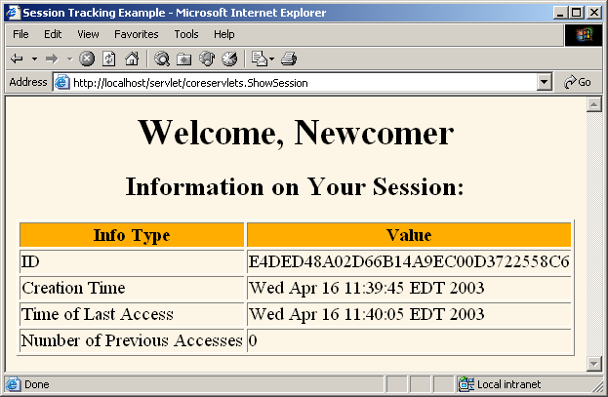
A Servlet that Shows (run it)
Access Counts (first Time) for a specific client

Slide 31
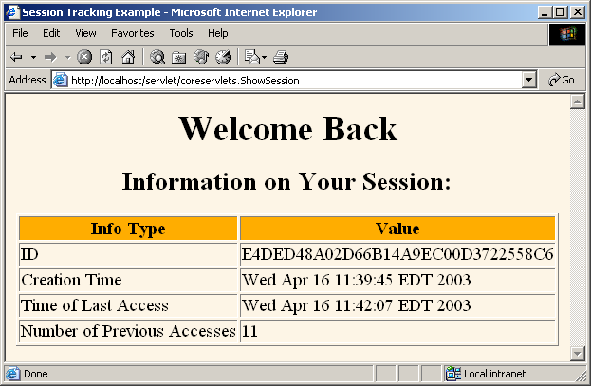
A Servlet that Shows Per-Client
Access Counts: (Welcome back)

Slide 32
Example #2 Overview (9.2 in book)
Provides a simple shopping cart.
Servlet that displays a list of items being ordered
Accumulates them in an ArrayList
  session attribute is called, “previousItems”
  Each time you add a new item,
    the item is added to the ArrayList.
      Without checking for duplicates – meant to demonstrate basic session tracking

Slide 33
package coreservlets;
import java.io.*;
import javax.servlet.*;
import javax.servlet.http.*;
import java.util.*;
public class ShowItems extends HttpServlet {
public void doGet(HttpServletRequest request,
HttpServletResponse response)
throws ServletException, IOException {
HttpSession session = request.getSession();
ArrayList previousItems =
(ArrayList)session.getAttribute("previousItems");
if (previousItems == null) {
previousItems = new ArrayList();
session.setAttribute("previousItems", previousItems);
}

Slide 34
String newItem = request.getParameter("newItem");
response.setContentType("text/html");
PrintWriter out = response.getWriter();
String title = "Items Purchased";
String docType =
"<!DOCTYPE HTML PUBLIC \"-//W3C//DTD HTML 4.0 " +
"Transitional//EN\">\n";
out.println(docType +
"<HTML>\n" +
"<HEAD><TITLE>" + title + "</TITLE></HEAD>\n" +
"<BODY BGCOLOR=\"#FDF5E6\">\n" +
"<H1>" + title + "</H1>");

Slide 35
synchronized(previousItems) {
if (newItem != null) {
previousItems.add(newItem); // add a new item
}
if (previousItems.size() == 0) { // No items
out.println("<I>No items</I>");
} else {
out.println("<UL>"); // print all items in array
for(int i=0; i<previousItems.size(); i++) {
out.println("<LI>" + (String)previousItems.get(i));
}
out.println("</UL>");
}
}
out.println("</BODY></HTML>");
}
}

Slide 36
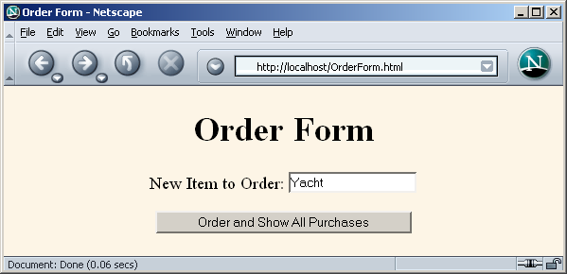
Accumulating a List of User Data:
Front End (OrderFrom.html)

Slide 37
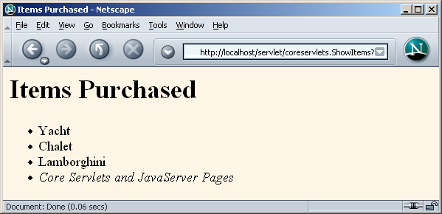
Accumulating a List of User Data: Result (run it)

Slide 38
Summary
The Session API is
  a simple, &
  powerful API
  that enables you to store session information about each user.
The Session API hides all the ugly details from you, so you can focus on your specific application.
Steps to using the Java Session API:
  Get the Session object from the HTTPRequest object.
  Extract Data from the user’s Session Object (getAttribute method)
  Add data to the user’s Session Object (putAttribute method)

